Slide 1

Sustainability of Local Government Audits
HB 5391
Government Reporting Enhancement and Transparency Act

Slide 2


Comptroller's Local Government Division
TEAMING
MILITARY JUSTICE
LEGAL ASSISTANCE
ILLINOIS’ LOCAL GOVERNMENT STATUTORY AUDIT REGIME
Government Account Audit Act
Counties Code Township Code Municipal Code

Slide 3
UNSUSTAINABILITY OF THE EXISTING LOCAL GOVERNMENT AUDIT REGIME
Comptroller's Local Government Division
TEAMING
MILITARY JUSTICE
LEGAL ASSISTANCE
Category | 2025 Delinquent Reports | Multi-Year Delinquent Reports
Municipal Governments | 318 | 202
Special Districts | 162 | 97
TOTAL | 480 | 299
42% Compliance Rate
20th Century Framework

Slide 4
House Bill 5391
21st Century Financial Reporting Framework
TEAMING
MILITARY JUSTICE
LEGAL ASSISTANCE
Government Report Enhancement
and Transparency Act
1 statewide Single Audit statute
4 categories of government based on annual revenues

Slide 5
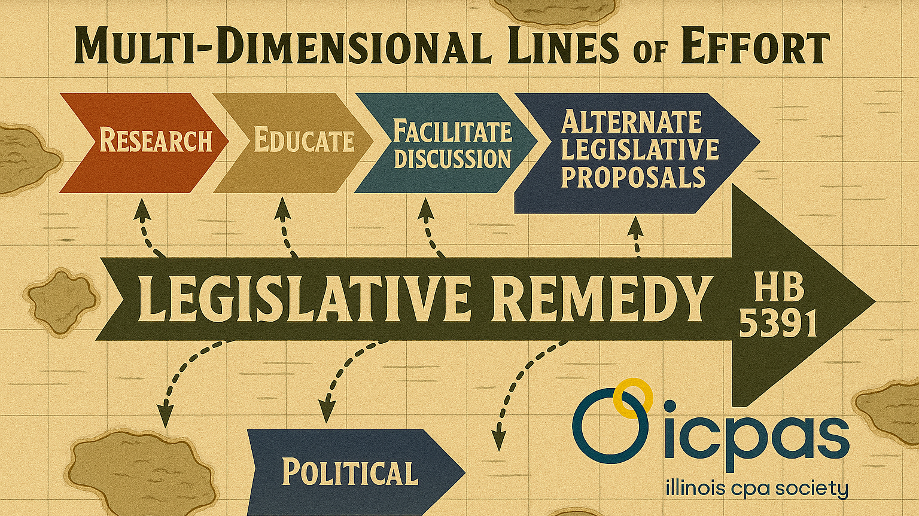

Slide 6

SETTING THE STAGE
Research
Extensive research project to identify challenges of
local government financial reporting challenges
Identifying the problems
Providing a long-term solution
Field work on small, medium and large size local governments
Develop reporting framework incorporating 21st century audit and reporting practices to ensure local government accountability in key fiscal and compliance areas

Slide 7
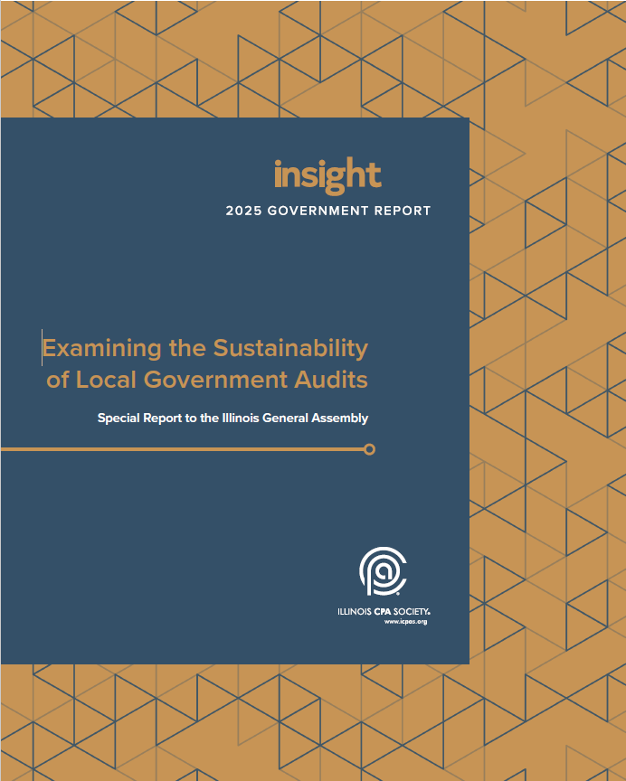
SETTING THE STAGE
Education
Special Report to the Illinois General Assembly, “Examining the Sustainability of Local Government Audits”
Seminal document for the General Assembly, comptroller candidates and local government stakeholder organizations
Educate the purpose of a financial statement audit
Highlight Illinois’ overreliance on financial statement audits to satisfy financial compliance filings with the comptroller
Provide an illustration of evolving complexities of government audit standards

Slide 8
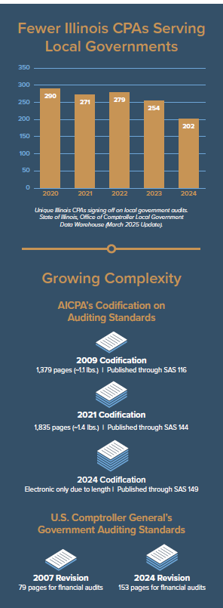
CHALLENGES TO LOCAL GOVERNMENT FINANCIAL REPORTING COMPLIANCE
CAUSE & EFFECT
Illinois’ large units of local government
  8,505 (Comptroller) vs.
  6,934 (Census Bureau)
Illinois’ layered statutory audit requirements
Structural deficiency of the Government Account Audit Act
Onerous government audit standards
Nationwide diminishing pool of CPAs performing government audits

Slide 9
LONG TERM SOLUTION
HB 5391 Government Reporting Enhancement and Transparency Act
Proposed 21st Century Reporting Framework based on local government accountability focusing on financial and compliance reporting
One statewide local government audit statute
Four categories of units of local government based on annual revenues with risk based escalating reporting requirements
Category | Report | Annual Cash Receipts $ Threshold | Frequency | Scope
4 | Two signed electronic reports | >$35M | Annual | GAAP¹ - GAAS/GAGAS⁵ AUPs³ Other Contractual⁴
3 | Two signed electronic reports | $3.5M - <$35M | Annual | Cash² - GAAS/GAGAS⁵ AUPs³ Other Contractual⁴
2 | One signed electronic report | $100K-<$3.5M | Annual | AUPs³
1 | Comptroller Template | <$100,000 | Annual | Independent Elector Audit Committee Inspection

Slide 10
Category 2
HB 5391
Government Reporting Enhancement and Transparency Act Categories of Local Governments & Reporting Standards
Report | One signed electronic report
Annual Cash Receipts $ Threshold | $100K-<$3.5M
Frequency | Annual
Scope | AUPs Agreed-upon procedures would review the overarching categories based on fiscal activities and review procedures from an accountability perspective. These would follow the AICPA’s Codification of Statements on Standards for Attestation Engagements. FISCAL ACCOUNTABILITY Cash Expenditures Freedom of Information Act Cash Receipts Open Meetings Act Banking Requirements Records Retention Reconciliations of Accounts Compensation of Officials Bond Requirements Capital Asset Record Keeping
Category 1
HB 5391
Government Reporting Enhancement and Transparency Act Categories of Local Governments & Reporting Standards
Report | Comptroller Template
Annual Cash Receipts $ Threshold | <$100,000
Frequency | Annual
Scope | Independent Elector Audit Committee Inspection

Slide 11
Report | Two signed electronic report
Annual Cash Receipts $ Threshold | $3.5M - <$35M
Frequency | Annual
Scope | Cash The local government would prepare its financial statements using the cash basis. GAAS/GAGAS The financial audit would follow the AICPA’s Codification of Statements on Auditing Standards and the GAO’s Yellow Book. AUPs Agreed-upon procedures would review the overarching categories based on fiscal activities and review procedures from an accountability perspective. These would follow the AICPA’s Codification of Statements on Standards for Attestation Engagements. FISCAL ACCOUNTABILITY Cash Expenditures Freedom of Information Act Cash Receipts Open Meetings Act Banking Requirements Records Retention Reconciliations of Accounts Compensation of Officials Bond Requirements Capital Asset Record Keeping Other Contractual Other contractual includes a Single Audit or bond covenants, when applicable.
Category 3
HB 5391
Government Reporting Enhancement and Transparency Act Categories of Local Governments & Reporting Standards

Slide 12
Report | Two signed electronic report
Annual Cash Receipts $ Threshold | >$35M
Frequency | Annual
Scope | GAAP (The local government would prepare its financial statements using U.S.) GAAS/GAGAS (The financial audit would follow the AICPA’s Codification of Statements on Auditing Standards and the GAO’s Yellow Book. ) AUPs Agreed-upon procedures would review the overarching categories based on fiscal activities and review procedures from an accountability perspective. These would follow the AICPA’s Codification of Statements on Standards for Attestation Engagements. FISCAL ACCOUNTABILITY Cash Expenditures Freedom of Information Act Cash Receipts Open Meetings Act Banking Requirements Records Retention Reconciliations of Accounts Compensation of Officials Bond Requirements Capital Asset Record Keeping Other Contractual Other contractual includes a Single Audit or bond covenants, when applicable.
Category 4
HB 5391
Government Reporting Enhancement and Transparency Act Categories of Local Governments & Reporting Standards

Slide 13
Legislative Process-
Legislative Proposals
Bill # | Description | Sponsor | Proponent
HB 4545/SB 3610 | -Government Account Audit Act -Increase Audit Threshold $1.5M | Rep. Blair-Sherlock Sen. Balkema | Park Districts Assoc.
HB 5391 | Govt Report Enhancement & Transparency Act | Rep. Manley | IL CPA Society
SB 2836 | -Government Account Audit Act -Increase Audit Threshold $1.4M -Conforming changes to Township Code | Sen. Johnson | Township Officials of Illinois
SB 3879 | -Township Code -Adds Section 55-70 creating a Township Auditing Entity to receive complaints | Sen. Morrison
SB 4037 | -Township Code -Financial Statement Review at the end of a term of office or vacancy | Sen. Bryant | Gray Township
Leveraging Long Term SOLUTION [HB 5391]
21st century statutory reporting regime
Structural deficiencies of the Government Account Audit Act
Facilitate discussions – Highlight unintended downstream consequences with other legislative proposals
FY27 begins the “Audit Armageddon” with implementation of quadrennial financial audits for certain municipalities
Seminal Document for the record in committee hearings + written testimony

Slide 14

LONG TERM SOLUTION
HB 5391
Government Reporting Enhancement and Transparency Act
COMPTROLLER BENEFITS
Enhanced enforcement tools for chronic noncompliers
Objective and transparent criteria for the Comptroller’s granting of waivers to local governments
Waiver transparency through the posting of a record of waivers and basis for waivers and formal notification to legislators of waivers
Comptroller adoption of administrative rules to adapt to special needs of specific units of local government
Comptroller develops standardized templates and procedures
Statewide database to assist local governments in RFQ for local government audits
  Centralized repository for units of local government to post their RFQ for CPAs to perform audits
  Centralized repository for CPAs and CPA firms to respond to RFQs from units of local government

Slide 15

LONG TERM SOLUTION
HB 5391-Government Reporting Enhancement and Transparency Act
LOCAL GOVERNMENT BENEFITS
Elimination of multiple and contradictory audit requirements
One stop centralized repository
Administrative rules to provide clarity and uniformity in reporting
  Guidance from the Comptroller on standardized templates and procedures
Less competition for audit resources
Revectoring reporting requirements of smaller units of local government as Category 1 and Category 2 governments will have agreed-upon procedures versus a full financial audit

Slide 16

LONG TERM SOLUTION
HB 5391 Government Reporting Enhancement and Transparency Act
CPA & CPA FIRMS
Incentivizes broadening of the pool of CPAs and CPA firms to perform procedures alleviating overutilization
Deployment of new reporting frameworks for smaller units of local governments - Category 1 and Category 2 local governments
Sweet spot – AUPs focused on accountability measures versus financial audits for Category 2 local governments, while focusing on financial audits for the larger Category 3 and Category 4 local governments
Peer Review - Engagement Review versus System Review for AUPs
Workforce multiplier to focus of CPA review and audit resources based on risk and higher-level reviews

Slide 17
G
TEAMING
MILITARY JUSTICE
LEGAL ASSISTANCE
QUESTIONS
21st Century Financial Reporting Framework
Government Report Enhancement
and Transparency Act
House Bill 5391

Slide 18

HIDDEN SLIDES
REFERNCE/BACKGROUND ONLY

Slide 19
Legislative Arena
Competing Legislative Proposals
Bill # | Description | Sponsor | Proponent
HB 4545/SB 3610 | -Government Account Audit Act -Increase Audit Threshold $1.5M | Rep. Blair-Sherlock Sen. Balkema | Park Districts Assoc.
HB 5391 | Govt Report Enhancement & Transparency Act | Rep. Manley | IL CPA Society
SB 2836 | -Government Account Audit Act -Increase Audit Threshold $1.4M -Conforming changes to Township Code | Sen. Johnson | Township Officials of Illinois
SB 3879 | -Township Code -Adds Section 55-70 creating a Township Auditing Entity to receive complaints | Sen. Morrison
SB 4037 | -Township Code -Financial Statement Review at the end of a term of office or vacancy | Sen. Bryant | Gray Township

